Slide 1
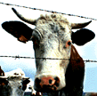
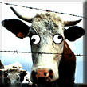
Public Service Announcement
How to identify if your cow has mad cows disease..
If your cow sound like this
then fire up the barbecue.
If your cow sounds like this
may we suggest the fish.
Notes:
1

